Slide 1
Sdcr3
Final Project

Slide 2
Agenda
Introduction
Tools
Screenshots & Results
Charts
Insights
Conclusion

Slide 3
Introduction

Slide 4
Introduction , goal and objective
Objective: Analyze sales data to uncover trends, customer behavior, top products, and profitability.
Data sources: Fact table + multiple dimension tables (Customer, Product, Date, etc.).
Goal: Provide actionable insights through a complete data pipeline.

Slide 5
Tools

Slide 6
Tools
Python: Cleaning ,Preparation ,EDA ,ML Models
Power BI: Data Modeling ,DAX ,Dashboards Design
SQL: Preparation ,Schemas ,Analytical Queries
Excel: Cleaning ,Transformation ,Pivot Tables , Dashboard

Slide 7
Results

Slide 8
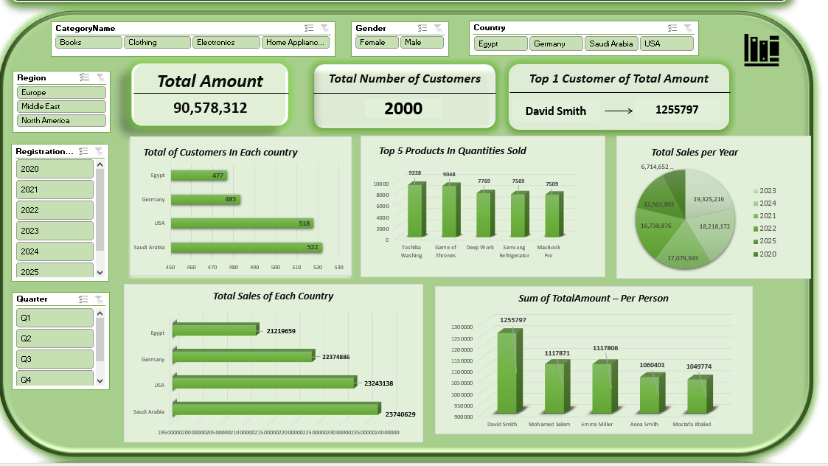
Excel Dashboard

Slide 9
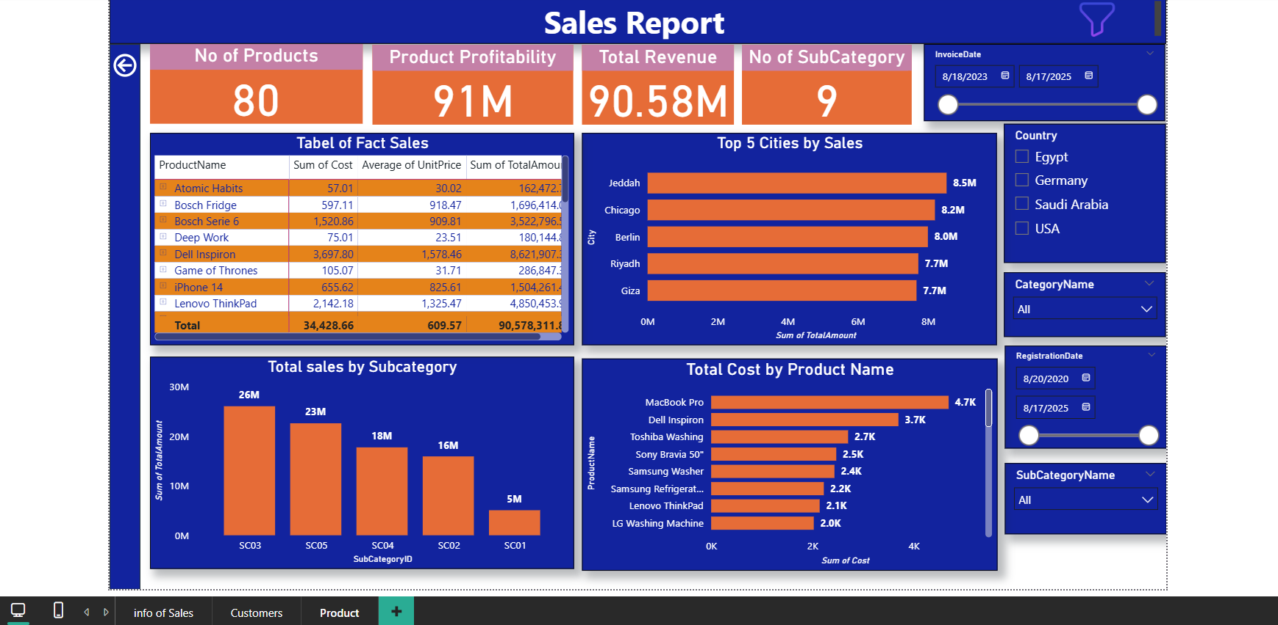
PBI Dashboard

Slide 10
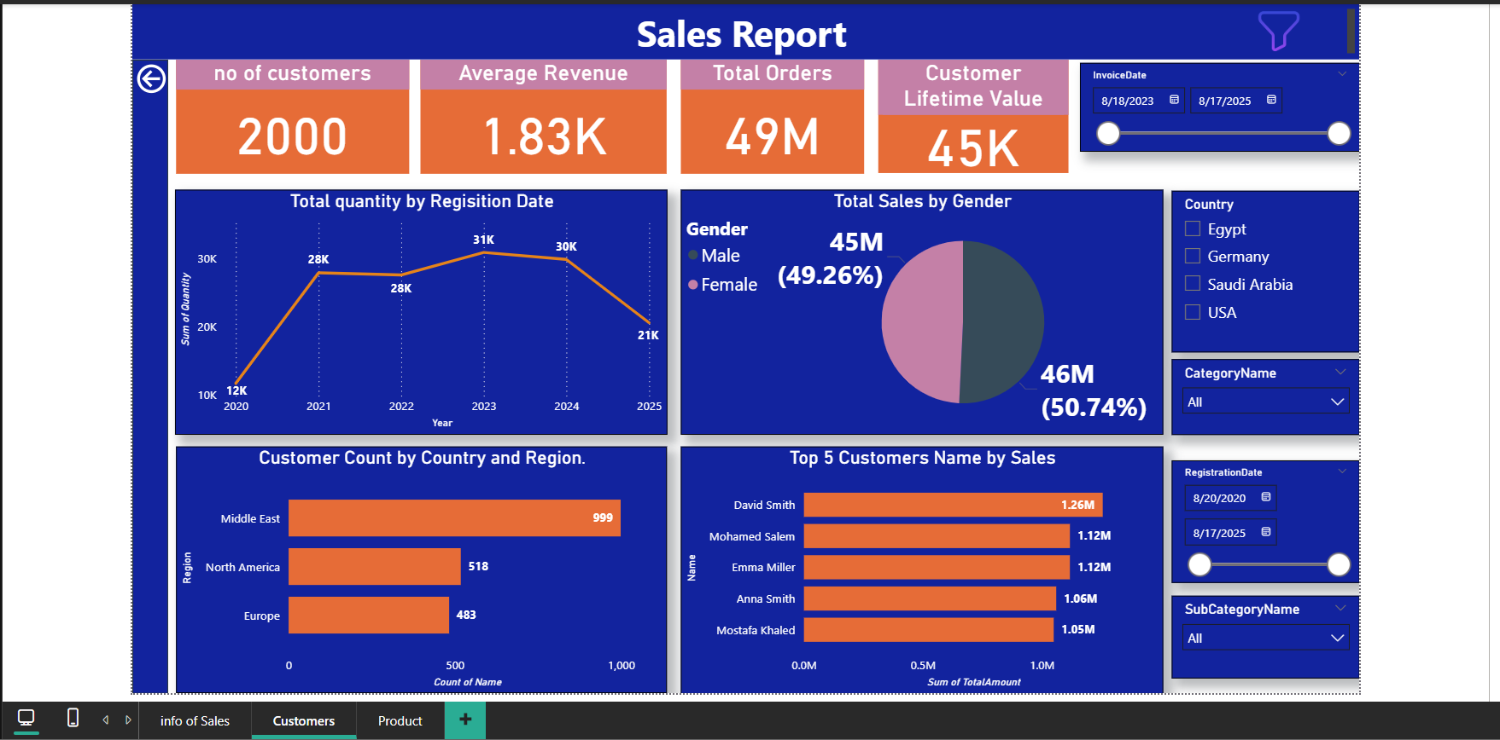
PBI Dashboard

Slide 11
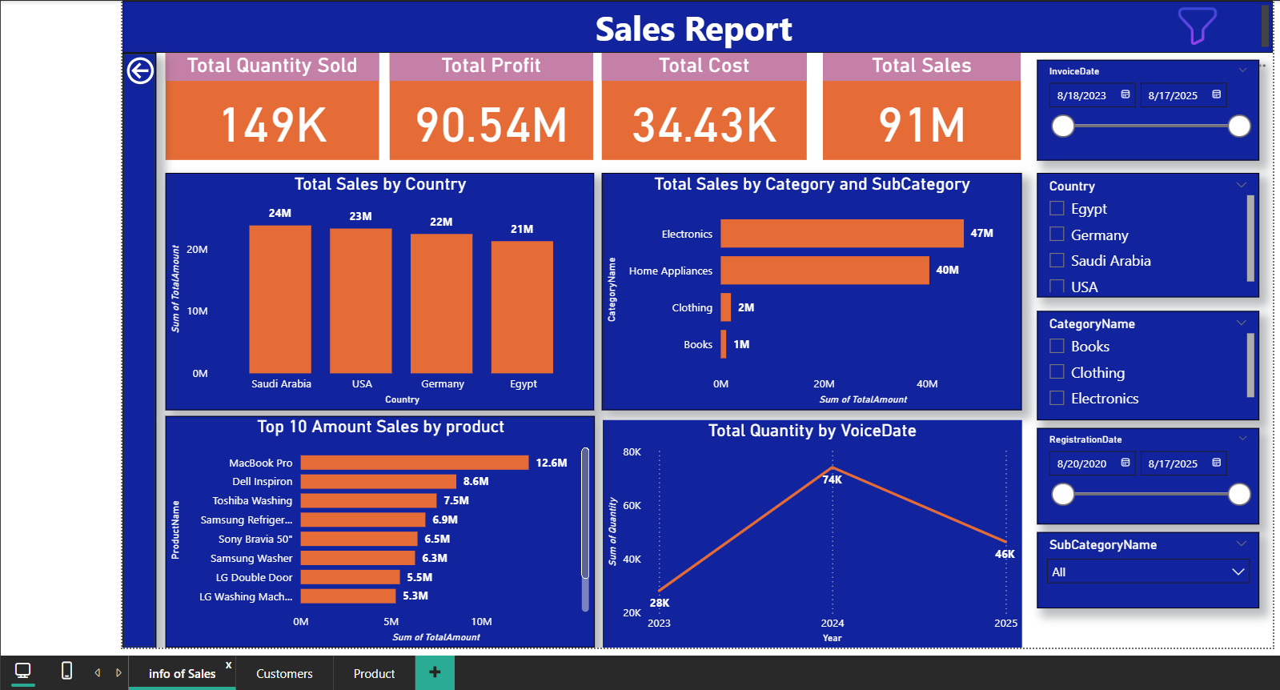
PBI Dashboard

Slide 12
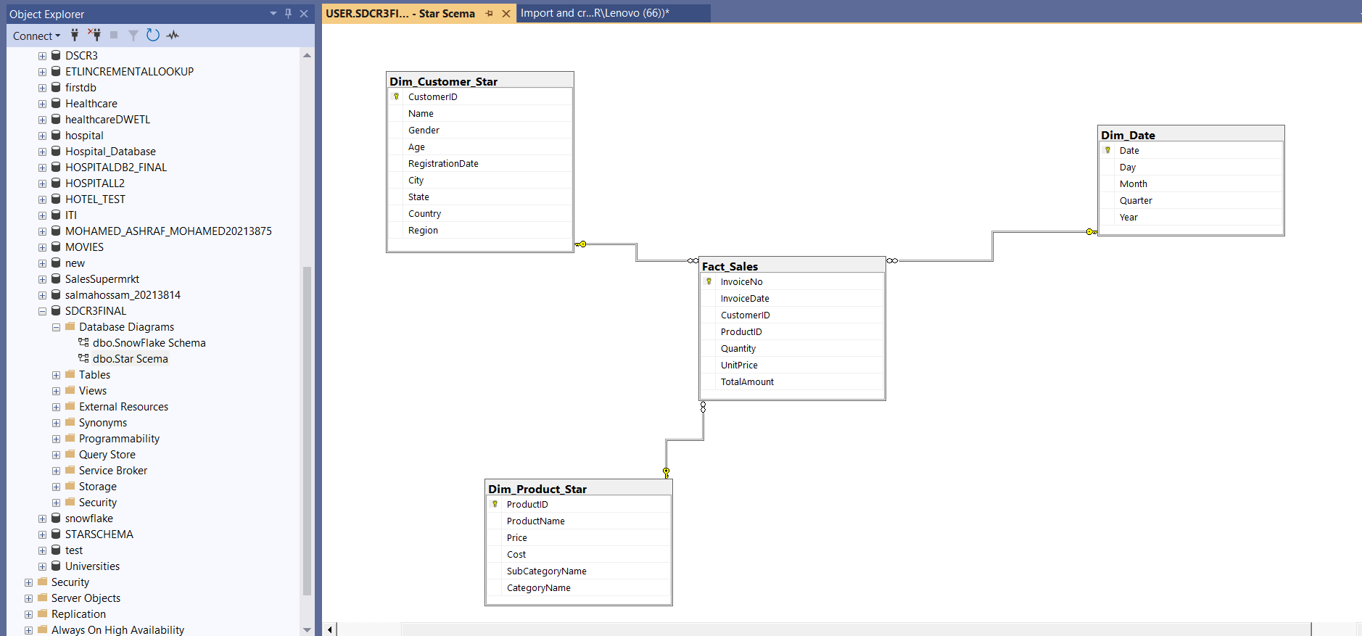
Star Schema

Slide 13
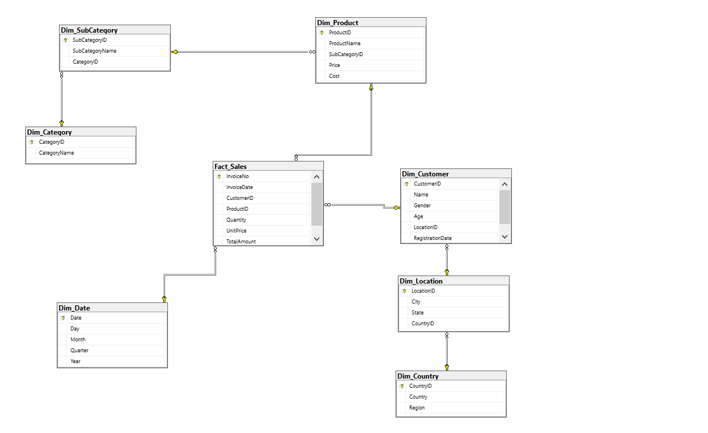
SnowFlake Schema

Slide 14
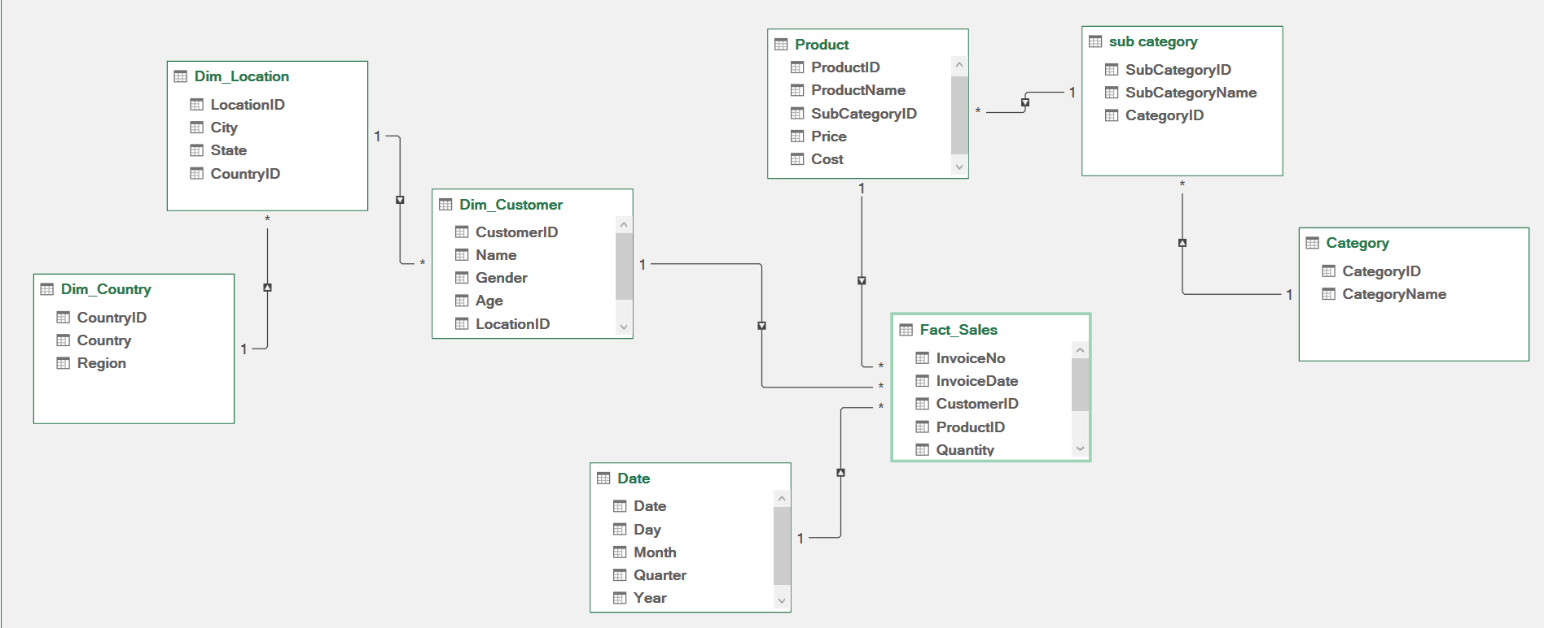
Data Modeling Excel

Slide 15
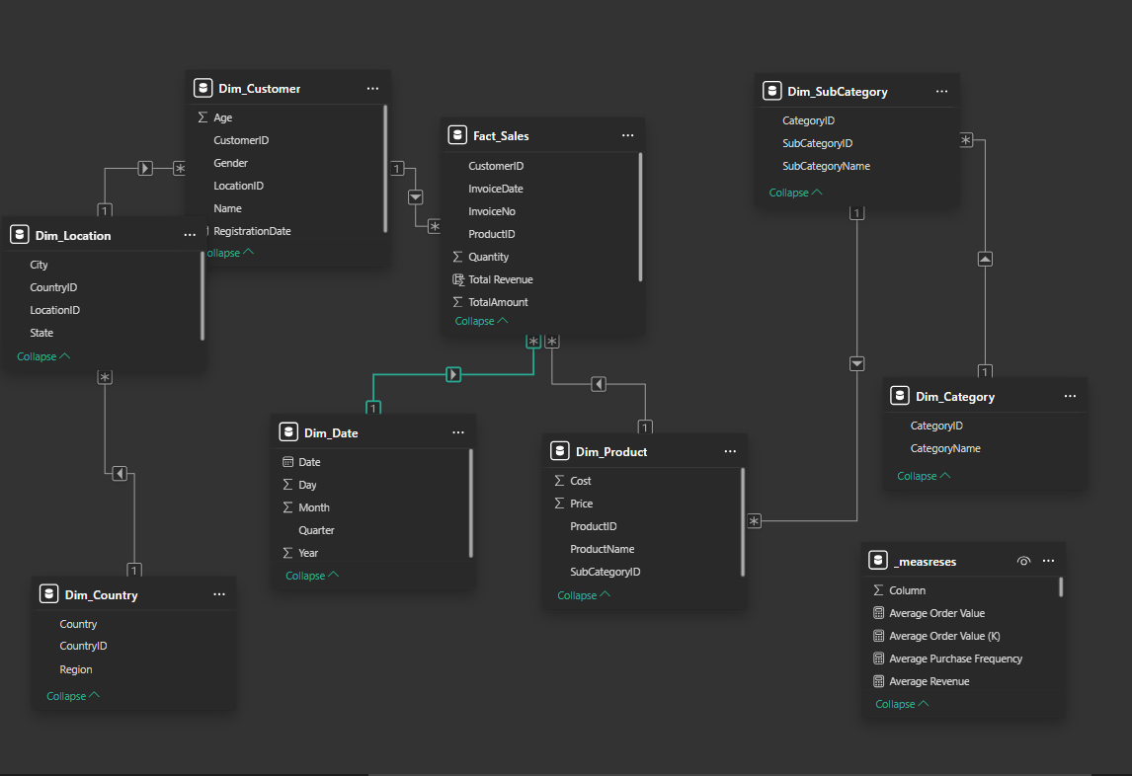
Data Modeling PBI

Slide 16
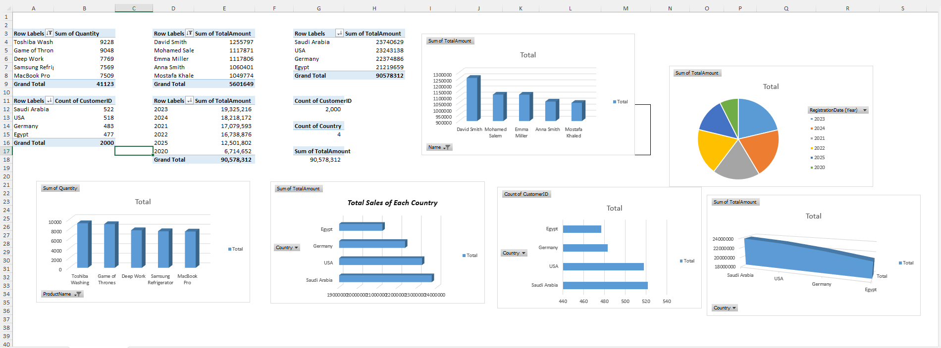
Excel Pivot Tables

Slide 17
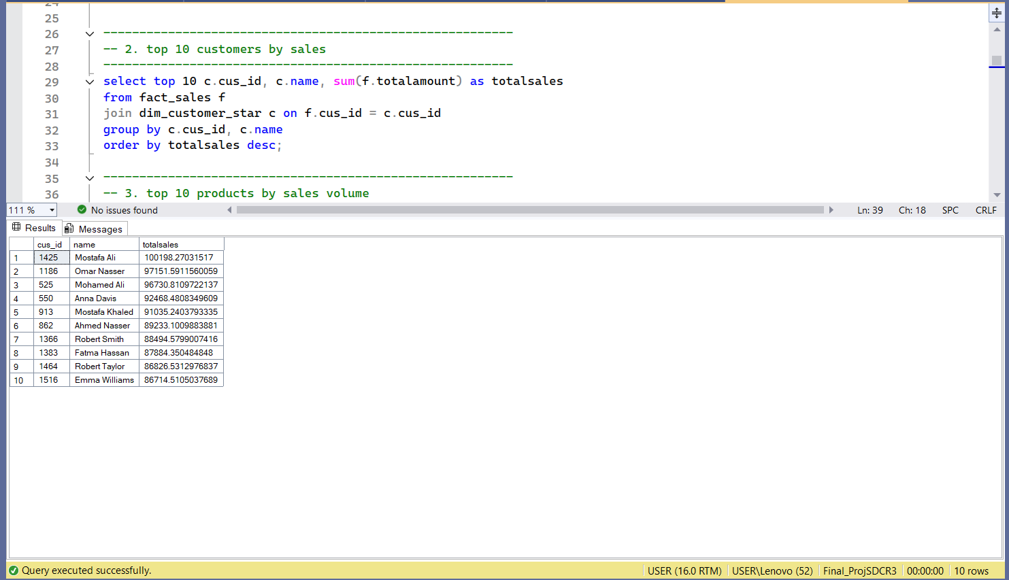
SQL Queries & Results

Slide 18
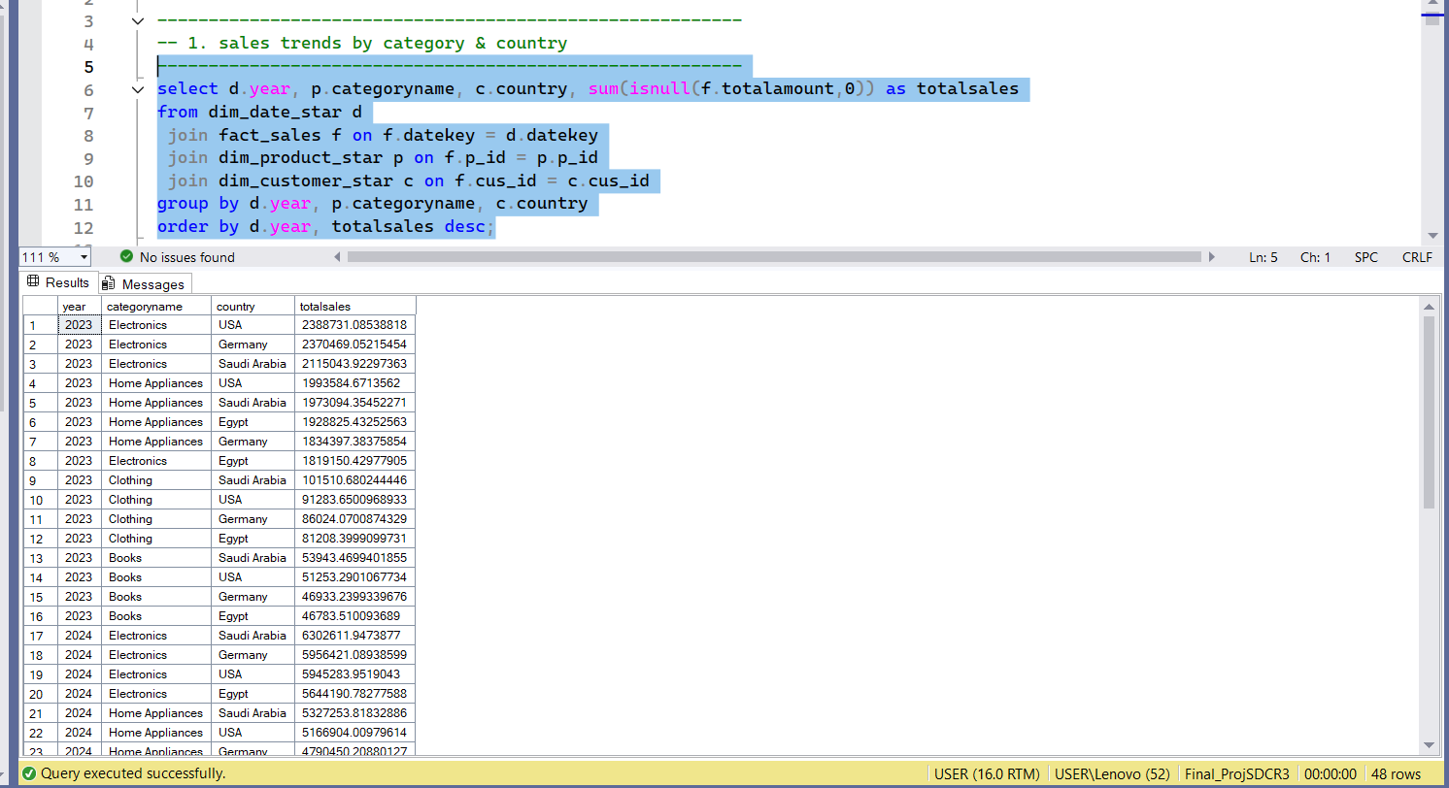
SQL Queries & Results

Slide 19
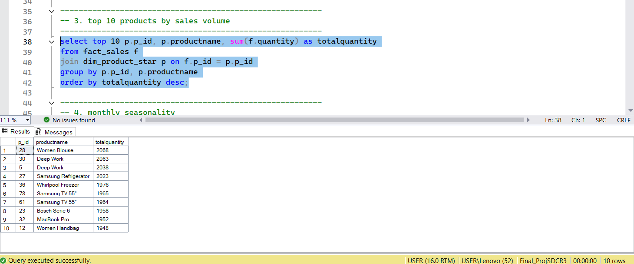
SQL Queries & Results

Slide 20
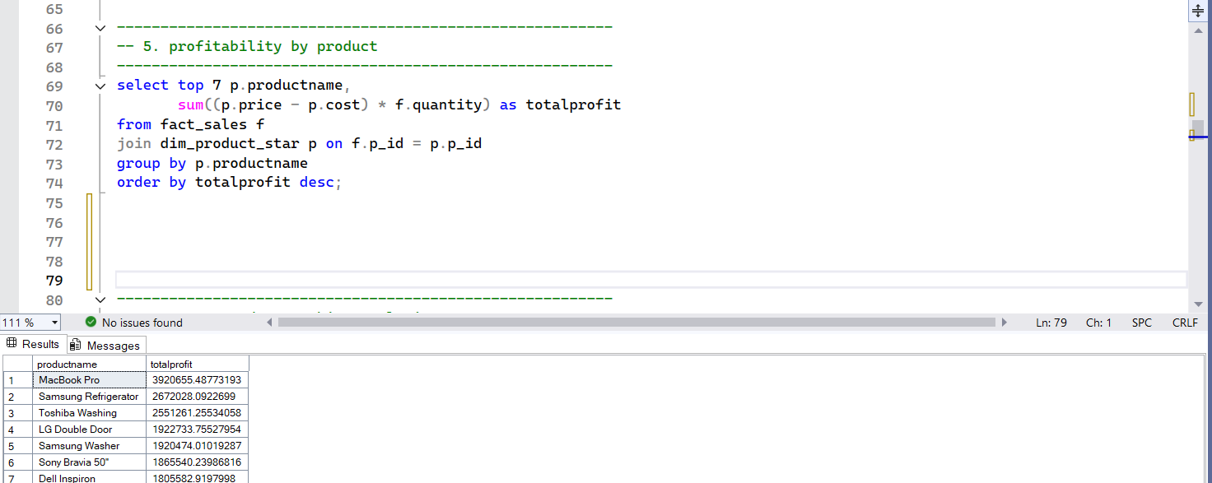
SQL Queries & Results

Slide 21
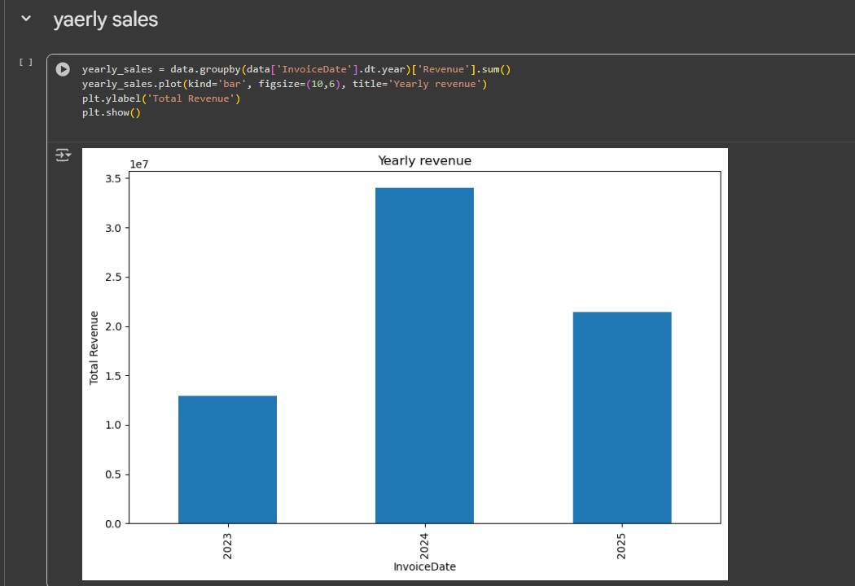
Python Results

Slide 22
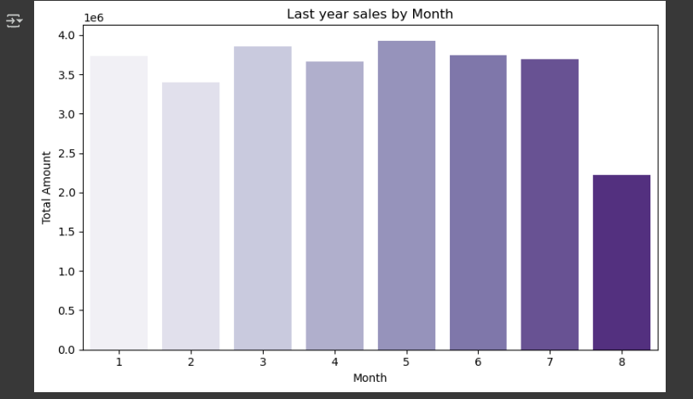
Python Results

Slide 23
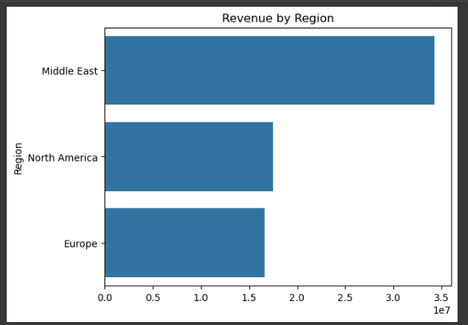
Python Results

Slide 24
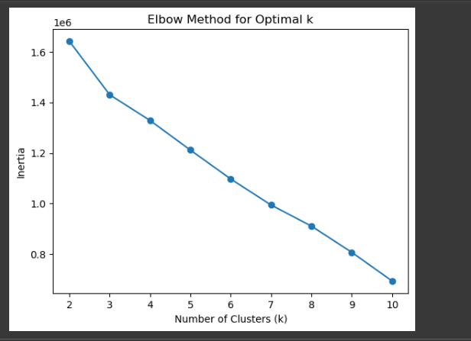
Python Results

Slide 25

Python Results

Slide 26
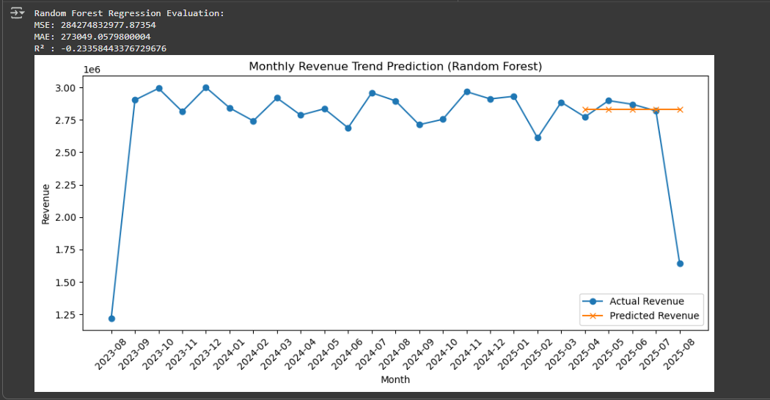
Python Results

Slide 27
Charts

Slide 28
Excel (Pivot + Charts)
Bar Chart – Top 5 Products by Quantity
Bar Chart – Top 5 Customers by Sales Amount
Horizontal Bar Chart – Sales by Country
3D Area Chart – Sales by Country
Pie Chart – Sales by Year
Horizontal Bar Chart – Customers by Country

Slide 29
Power BI – Sales Dashboard
KPI Cards – Total Quantity, Profit, Cost, Sales
Column Chart – Total Sales by Country
Horizontal Bar Chart – Sales by Category & SubCategory
Horizontal Bar Chart – Top 10 Products by Sales
Line Chart – Quantity Sold by Year

Slide 30
Power BI – Customers Dashboard
KPI Cards – No. of Customers, Avg Revenue, Total Orders, CLV
Line Chart – Quantity by Registration Date (Year)
Pie Chart – Sales by Gender
Horizontal Bar Chart – Customer Count by Region
Horizontal Bar Chart – Top 5 Customers by Sales

Slide 31
Power BI – Product Dashboard
KPI Cards – No. of Products, Profitability, Total Revenue, No. of Subcategories
Table – Fact Sales (Product, Cost, Unit Price, Total Amount)
Horizontal Bar Chart – Top 5 Cities by Sales
Column Chart – Total Sales by SubCategory
Horizontal Bar Chart – Total Cost by Product

Slide 32
Insights

Slide 33
excel
Top Products: Toshiba Washing (9.2K units), Game of Thrones (9K), Deep Work (7.7K).
Top Customers: David Smith (1.26M) is the largest buyer, followed by Mohamed Salem (1.12M).
Sales by Country: Saudi Arabia (23.7M) slightly ahead of USA (23.2M).
Sales by Year: Highest in 2024 (18.2M), lowest in 2020 (6.7M).
Customer Distribution: Saudi Arabia has the largest customer base (522).

Slide 34
Pbi
Sales Dashboard:
KPIs: 149K products sold, 91M total sales, 90.54M profit, 34.4K cost.
By Country: Saudi Arabia leads at 24M, followed by USA (23M).
By Category: Electronics (47M) and Home Appliances (40M) dominate.
Top Products: MacBook Pro (12.6M), Dell Inspiron (8.6M).
Quantity Trend: Strong growth in 2024 (74K) then a drop in 2025 (46K).

Slide 35
Pbi
Customers Dashboard:
KPIs: 2,000 customers, 49M total orders, 1.83K avg revenue.
By Gender: Balanced – Male (45M, 49%), Female (46M, 51%).
By Region: Middle East dominates with ~1,000 customers.
Top Customers: Same leaders as Excel (David Smith 1.26M).

Slide 36
Pbi
Product Dashboard
KPIs: 80 products, 9 subcategories, 91M profitability.
Top Cities: Jeddah (8.5M), Chicago (8.2M), Berlin (8M).
By SubCategory: SC03 leads (26M), SC01 lowest (5M).
Cost Analysis: MacBook Pro has the highest cost (4.7K).

Slide 37
Conclusion

Slide 38
Summary & Conclusion
Excel provided initial aggregation and validation of data (Top Products, Top Customers, Country/Year comparisons).
Power BI enhanced the analysis with interactive dashboards, deeper breakdowns (gender, region, city, subcategory), and financial KPIs.
Key Business Insights:
  Top revenue products: MacBook Pro & Dell Inspiron
  Top market: Saudi Arabia leads slightly ahead of USA
  Customer base: Balanced across countries, with Middle East strongest
  Growth trend: Peak sales & quantities in 2024, dip in 2025
  Demographics: Sales almost equally split between male & female customers

Slide 39
Summary & Conclusion
Python Conclusion:
  Used for data exploration & preprocessing (date features: Year, Month, Quarter).
  Applied feature engineering (category encoding, aggregations).
  Built predictive models (Regression, Random Forest) to estimate future sales.
  Evaluated models with accuracy scores → showed that machine learning can forecast sales trends.
  Python added predictive power and deeper analysis beyond Excel/Power BI dashboards.

Slide 40
Summary & Conclusion
SQL Conclusion:
  Designed a star schema (Fact_Sales + Dimension tables: Product, Customer, Date, etc.).
  Applied joins to merge Fact & Dim tables for analysis.
  Ran queries for key insights:
    Profitability by product (Revenue – Cost).
    Top customers & products.
    Demographics (Gender, Region, Age groups).
    Yearly & monthly sales trends.
  Ensured data integrity with keys & constraints → clean & consistent database for analysis.
  SQL was the foundation layer → structured, cleaned, and prepared the data for Excel, Python, and Power BI.

Slide 41
THANK YOU
Mohamed Ekramy
Moataz Gamal
Mohamed Afify
Yasmin Farag
Mohamed Ashraf
Zeyad Zakaria

